Slide 1
FAKE NEWS PROJECT
Problem statement:
The authenticity of Information has become a longstanding issue affecting businesses and society, both for printed and digital media. On social networks, the reach and effects of information spread occur at such a fast pace and so amplified that distorted, inaccurate, or false information acquires a tremendous potential to cause real-world impacts, within minutes, for millions of users. Recently, several public concerns about this problem and some approaches to mitigate the problem were expressed.

Slide 2
DATA set Description
Data- Description:
There are 6 columns in the dataset provided to you. The description of each of the column is given below:
“id”: Unique id of each news article
“headline”: It is the title of the news.
“news”: It contains the full text of the news article
“Unnamed:0”: It is a serial number
“written_by”: It represents the author of the news article
“label”: It tells whether the news is fake (1) or not fake (0).

Slide 3
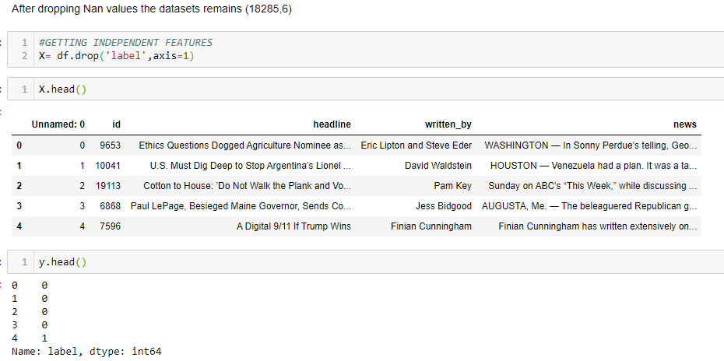
DATA PREPROCESSING
It includes the data processing and wrangling step by step .

Slide 4
NATURAL LANGUAGE PROCESSING
The NLP procedure in fake news classifier is very essential.
In NLP we used countvectorizer and tfidfvectorizer and hashing vectorizer.
These models algorithm will give us a best accuracy on confusion matrix.
Also we can use best model evalution process to get best accuracy in this dataset.

Slide 5
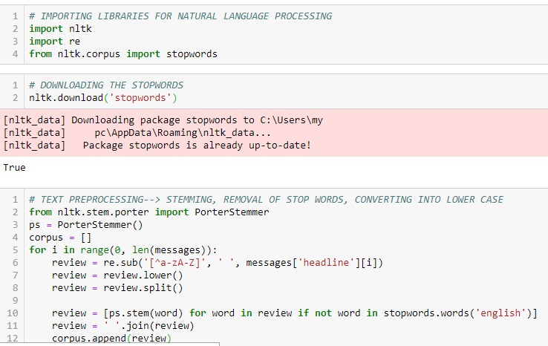
STEP BY STEP EDA PROCESS IN NLP

Slide 6
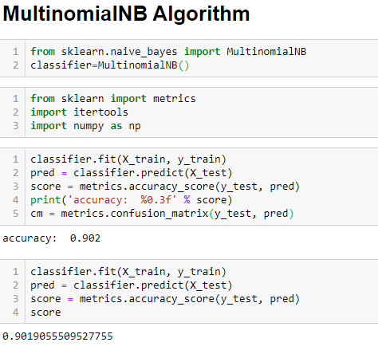
Model Deployment process
In this step we will use multinomialNB to get our best accuracy and also we will use hyper parameter to get best results.

Slide 7
Best Accuracy
As we got the our best accuracy by using MulinomialNB is 90% by dropping some nan values and after data preprocessing steps we finally get our best results after model deployment.

Slide 8
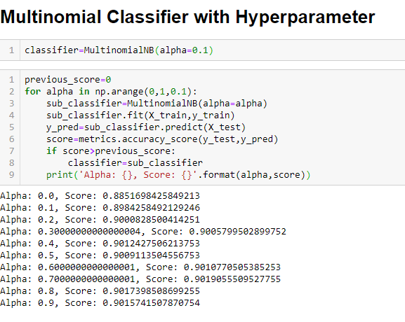
Using HYPERPARAMETER Algorithm
Multinomial classifier with hyperparameter.

